Slide 1
DIGICHROME ACADEMY
NEXT HIKES
2023-24

Slide 2
PROJECT – 03
EXPLORATORY DATA ANALYSIS (EDA) FOR REAL ESTATE PRICING
ANKUR KUMAR GIRI
2023-24

Slide 3
PROBLEM STATEMENT
IN THE DYNAMIC LANDSCAPE OF THE RESIDENTIAL REAL ESTATE MARKET, DETERMINING AN OPTIMAL AND COMPETITIVE PRICE FOR A HOUSE IS A MULTIFACETED CHALLENGE. AS A KEY MEMBER OF THE ANALYTICS TEAM IN A LEADING REAL ESTATE COMPANY, YOUR TASK IS TO CONDUCT A COMPREHENSIVE ANALYSIS TO IDENTIFY AND UNDERSTAND THE MYRIAD VARIABLES THAT SIGNIFICANTLY INFLUENCE HOUSE PRICES. BY LEVERAGING ADVANCED DATA ANALYTICS TECHNIQUES AND VISUALIZATION TOOLS, YOUR GOAL IS TO UNCOVER PATTERNS, CORRELATIONS, AND TRENDS WITHIN THE DATASET, ENABLING THE COMPANY TO MAKE INFORMED DECISIONS AND STRATEGICALLY POSITION PROPERTIES FOR BETTER BUSINESS OPPORTUNITIES

Slide 4
SITUATION OVERVIEW
THE REAL ESTATE INDUSTRY IS INHERENTLY COMPLEX, INFLUENCED BY NUMEROUS FACTORS THAT COLLECTIVELY IMPACT THE PRICING OF RESIDENTIAL PROPERTIES. THE TASK AT HAND IS TO NAVIGATE THROUGH THIS COMPLEXITY AND EXTRACT MEANINGFUL INSIGHTS FROM THE AVAILABLE DATA. AS AN ANALYTICS PROFESSIONAL, YOU ARE ENTRUSTED WITH THE RESPONSIBILITY TO NOT ONLY IDENTIFY THE KEY VARIABLES AFFECTING HOUSE PRICES BUT ALSO TO PROVIDE ACTIONABLE RECOMMENDATIONS BASED ON YOUR FINDINGS.
THE DATASET AT YOUR DISPOSAL COMPRISES DIVERSE PARAMETERS SUCH AS LOCATION, SIZE, AMENITIES, MARKET TRENDS, ECONOMIC INDICATORS, AND HISTORICAL TRANSACTION DATA. THESE VARIABLES CONTRIBUTE TO THE INTRICATE WEB OF PRICING DYNAMICS, AND YOUR ROLE IS TO UNRAVEL THEIR INTERDEPENDENCIES THROUGH METICULOUS ANALYSIS.

Slide 5
EXPLORATORY DATA ANALYSIS (EDA)
CONTENTS
STEPS IN EXPLORATORY DATA ANALYSIS (EDA)
SOFTWARE REQUIREMENTS
FLOW CHART OF EXPLORATORY DATA ANALYSIS .

Slide 6
EXPLORATORY DATA ANALYSIS
EXPLORATORY DATA ANALYSIS (EDA) IS A CRUCIAL INITIAL STEP IN ANY DATA ANALYSIS PROJECT. IT INVOLVES EXAMINING AND UNDERSTANDING THE CHARACTERISTICS, PATTERNS, AND RELATIONSHIPS PRESENT IN A DATASET. EDA ALLOWS DATA SCIENTISTS AND ANALYSTS TO GAIN INSIGHTS INTO THE DATA, IDENTIFY POTENTIAL PROBLEMS OR ANOMALIES, AND FORMULATE HYPOTHESES FOR FURTHER INVESTIGATION.
UNDERSTAND THE DATA: GET A COMPREHENSIVE UNDERSTANDING OF THE DATASET, INCLUDING ITS STRUCTURE, VARIABLES, AND THEIR TYPES. THIS INVOLVES EXPLORING THE DIMENSIONS OF THE DATASET (NUMBER OF ROWS AND COLUMNS), DATA TYPES (NUMERIC, CATEGORICAL, ETC.), AND ANY MISSING OR NULL VALUES.

Slide 7
EXPLORATORY DATA ANALYSIS
DETECT PATTERNS AND RELATIONSHIPS: IDENTIFY PATTERNS, TRENDS, AND RELATIONSHIPS BETWEEN VARIABLES IN THE DATASET. THIS INCLUDES EXAMINING DISTRIBUTIONS, CORRELATIONS, AND DEPENDENCIES AMONG DIFFERENT FEATURES
UNCOVER ANOMALIES AND OUTLIERS: DETECT ANY OUTLIERS OR ANOMALIES THAT MAY INDICATE ERRORS IN DATA COLLECTION OR PROCESSING. THESE OUTLIERS COULD BE LEGITIMATE DATA POINTS WITH UNUSUAL CHARACTERISTICS OR ERRORS THAT NEED TO BE ADDRESSED.
FORMULATE HYPOTHESES: BASED ON THE INSIGHTS GAINED FROM EDA, GENERATE HYPOTHESES OR RESEARCH QUESTIONS TO EXPLORE FURTHER THROUGH STATISTICAL ANALYSIS OR MACHINE LEARNING MODELING

Slide 8
EXPLORATORY DATA ANALYSIS
EDA IS TYPICALLY PERFORMED USING A COMBINATION OF DESCRIPTIVE STATISTICS, DATA VISUALIZATION TECHNIQUES, AND SOMETIMES, ADVANCED ANALYTICS METHODS. DESCRIPTIVE STATISTICS HELP SUMMARIZE THE CENTRAL TENDENCY, DISPERSION, AND SHAPE OF THE DATA, WHILE VISUALIZATION TECHNIQUES SUCH AS HISTOGRAMS, SCATTER PLOTS, BOX PLOTS, AND HEATMAPS PROVIDE GRAPHICAL REPRESENTATIONS OF THE DATA DISTRIBUTION AND RELATIONSHIPS.
EDA IS AN ITERATIVE PROCESS, WHERE INSIGHTS GAINED AT EACH STAGE MAY LEAD TO FURTHER EXPLORATION OR REFINEMENT OF ANALYSIS TECHNIQUES. IT SERVES AS A FOUNDATION FOR MORE ADVANCED ANALYSIS AND MODELING TASKS, HELPING ENSURE THAT SUBSEQUENT ANALYSES ARE BASED ON A SOLID UNDERSTANDING OF THE DATASET.
IN SUMMARY, EXPLORATORY DATA ANALYSIS IS A CRITICAL PHASE IN THE DATA ANALYSIS WORKFLOW, ENABLING DATA SCIENTISTS AND ANALYSTS TO GAIN INSIGHTS, IDENTIFY PATTERNS, AND FORMULATE HYPOTHESES TO GUIDE FURTHER ANALYSIS AND DECISION-MAKING.

Slide 9
STEPS IN EXPLORATORY DATA ANALYSIS (EDA)
EXPLORATORY DATA ANALYSIS (EDA) IS A CRITICAL STEP IN DATA ANALYSIS WHERE YOU EXAMINE AND SUMMARIZE THE MAIN CHARACTERISTICS OF A DATASET, USUALLY THROUGH VISUALIZATION AND DESCRIPTIVE STATISTICS. IT HELPS YOU UNDERSTAND YOUR DATA, FIND PATTERNS, DETECT ANOMALIES, AND FORMULATE HYPOTHESES FOR FURTHER ANALYSIS. EDA INVOLVES TASKS LIKE:
DATA CLEANING: HANDLING MISSING VALUES, DEALING WITH OUTLIERS, AND RESOLVING INCONSISTENCIES IN THE DATA.
DESCRIPTIVE STATISTICS: COMPUTING MEASURES LIKE MEAN, MEDIAN, MODE, STANDARD DEVIATION, ETC., TO UNDERSTAND THE CENTRAL TENDENCY AND DISPERSION OF THE DATA.
VISUALIZATION: CREATING PLOTS SUCH AS HISTOGRAMS, BOX PLOTS, SCATTER PLOTS, AND HEATMAPS TO VISUALIZE THE DISTRIBUTION, RELATIONSHIPS, AND TRENDS IN THE DATA.
FEATURE ENGINEERING: CREATING NEW FEATURES FROM EXISTING ONES OR TRANSFORMING FEATURES TO BETTER REPRESENT THE UNDERLYING PATTERNS IN THE DATA.

Slide 10
STEPS IN EXPLORATORY DATA ANALYSIS (EDA)
EXPLORATORY DATA ANALYSIS (EDA) IS A CRITICAL STEP IN DATA ANALYSIS WHERE YOU EXAMINE AND SUMMARIZE THE MAIN CHARACTERISTICS OF A DATASET, USUALLY THROUGH VISUALIZATION AND DESCRIPTIVE STATISTICS. IT HELPS YOU UNDERSTAND YOUR DATA, FIND PATTERNS, DETECT ANOMALIES, AND FORMULATE HYPOTHESES FOR FURTHER ANALYSIS. EDA INVOLVES TASKS LIKE:
DATA CLEANING: HANDLING MISSING VALUES, DEALING WITH OUTLIERS, AND RESOLVING INCONSISTENCIES IN THE DATA.
DESCRIPTIVE STATISTICS: COMPUTING MEASURES LIKE MEAN, MEDIAN, MODE, STANDARD DEVIATION, ETC., TO UNDERSTAND THE CENTRAL TENDENCY AND DISPERSION OF THE DATA.
VISUALIZATION: CREATING PLOTS SUCH AS HISTOGRAMS, BOX PLOTS, SCATTER PLOTS, AND HEATMAPS TO VISUALIZE THE DISTRIBUTION, RELATIONSHIPS, AND TRENDS IN THE DATA.
DIMENSIONALITY REDUCTION: TECHNIQUES LIKE PRINCIPAL COMPONENT ANALYSIS (PCA) OR T-DISTRIBUTED STOCHASTIC NEIGHBOR EMBEDDING (T-SNE) TO REDUCE THE NUMBER OF FEATURES AND SIMPLIFY THE DATASET WHILE PRESERVING ITS ESSENTIAL CHARACTERISTICS.

Slide 11
STEPS IN EXPLORATORY DATA ANALYSIS (EDA)
CORRELATION ANALYSIS: EXAMINING THE RELATIONSHIPS BETWEEN VARIABLES TO IDENTIFY POTENTIAL DEPENDENCIES OR MULTICOLLINEARITY
UNDERSTANDING THE DATA: START BY LOADING YOUR DATASET AND UNDERSTANDING ITS STRUCTURE. LOOK AT THE DIMENSIONS (NUMBER OF ROWS AND COLUMNS), DATA TYPES, AND ANY MISSING VALUES. THIS STAGE INVOLVES GETTING A GENERAL SENSE OF WHAT INFORMATION IS AVAILABLE AND ITS QUALITY.
UNIVARIATE ANALYSIS: ANALYZE INDIVIDUAL VARIABLES ONE AT A TIME. THIS CAN INVOLVE COMPUTING SUMMARY STATISTICS LIKE MEAN, MEDIAN, AND STANDARD DEVIATION FOR NUMERICAL VARIABLES, AND FREQUENCY TABLES OR BAR PLOTS FOR CATEGORICAL VARIABLES. HISTOGRAMS, DENSITY PLOTS, AND BOX PLOTS ARE USEFUL FOR VISUALIZING THE DISTRIBUTION AND SPREAD OF NUMERICAL VARIABLES.
BIVARIATE ANALYSIS: EXPLORE RELATIONSHIPS BETWEEN PAIRS OF VARIABLES. THIS CAN INVOLVE SCATTER PLOTS FOR NUMERIC VARIABLES, OR CONTINGENCY TABLES AND HEATMAP CORRELATION MATRICES FOR CATEGORICAL VARIABLES. UNDERSTANDING THESE RELATIONSHIPS CAN PROVIDE INSIGHTS INTO POTENTIAL PATTERNS OR DEPENDENCIES IN THE DATA.

Slide 12
STEPS IN EXPLORATORY DATA ANALYSIS (EDA)
MULTIVARIATE ANALYSIS: INVESTIGATE INTERACTIONS BETWEEN THREE OR MORE VARIABLES. THIS CAN INVOLVE TECHNIQUES LIKE CLUSTER ANALYSIS, FACTOR ANALYSIS, OR MULTIDIMENSIONAL SCALING TO IDENTIFY GROUPS OR PATTERNS WITHIN THE DATA.
STATISTICAL TESTING: PERFORM STATISTICAL TESTS TO VALIDATE HYPOTHESES OR ASSESS THE SIGNIFICANCE OF RELATIONSHIPS OBSERVED DURING THE ANALYSIS. THIS CAN INCLUDE T-TESTS, ANOVA, CHI-SQUARE TESTS, AND CORRELATION TESTS, DEPENDING ON THE NATURE OF YOUR DATA AND RESEARCH QUESTIONS
DIMENSIONALITY REDUCTION: TECHNIQUES LIKE PRINCIPAL COMPONENT ANALYSIS (PCA) OR T-DISTRIBUTED STOCHASTIC NEIGHBOR EMBEDDING (T-SNE) TO REDUCE THE NUMBER OF FEATURES AND SIMPLIFY THE DATASET WHILE PRESERVING ITS ESSENTIAL CHARACTERISTICS.
FEATURE ENGINEERING: CREATING NEW FEATURES FROM EXISTING ONES OR TRANSFORMING FEATURES TO BETTER REPRESENT THE UNDERLYING PATTERNS IN THE DATA.

Slide 13
SOFTWARE REQUIREMENTS
GOOGLE DRIVE
COLAB

Slide 14
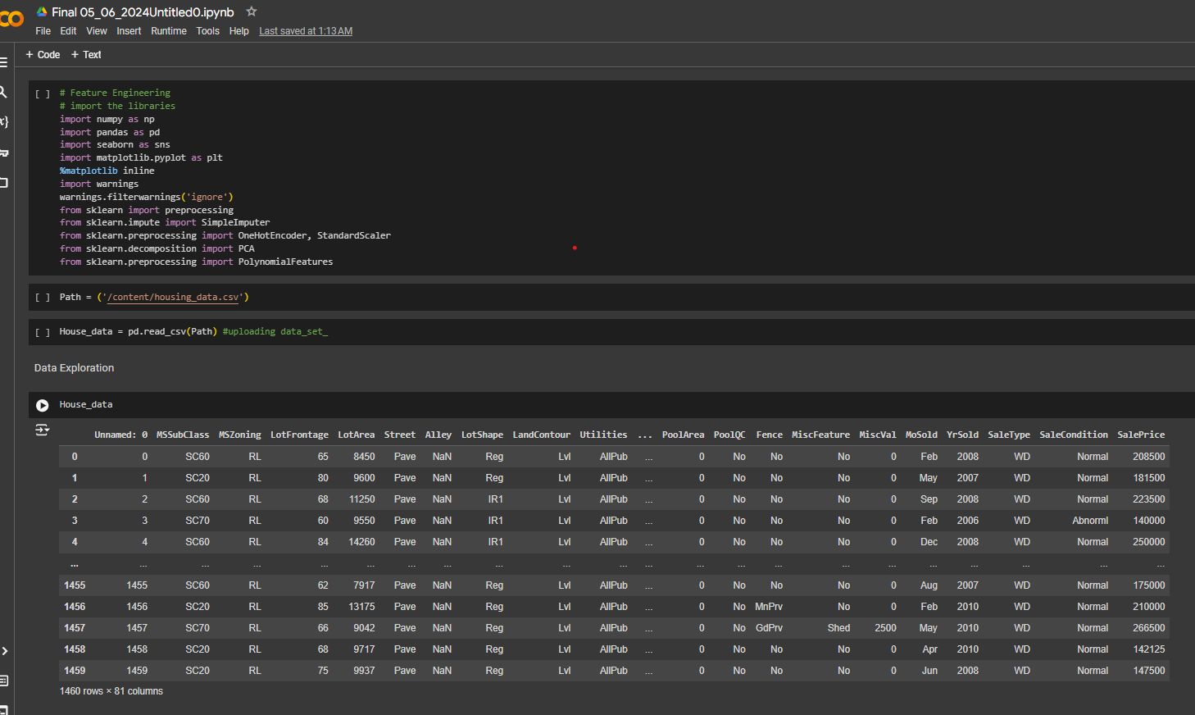
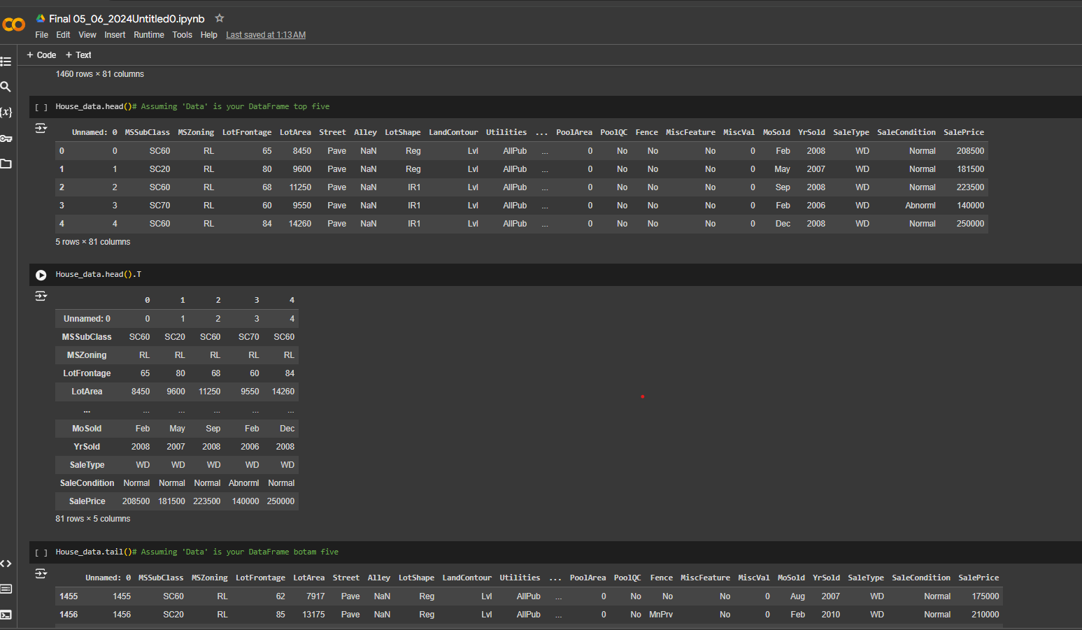
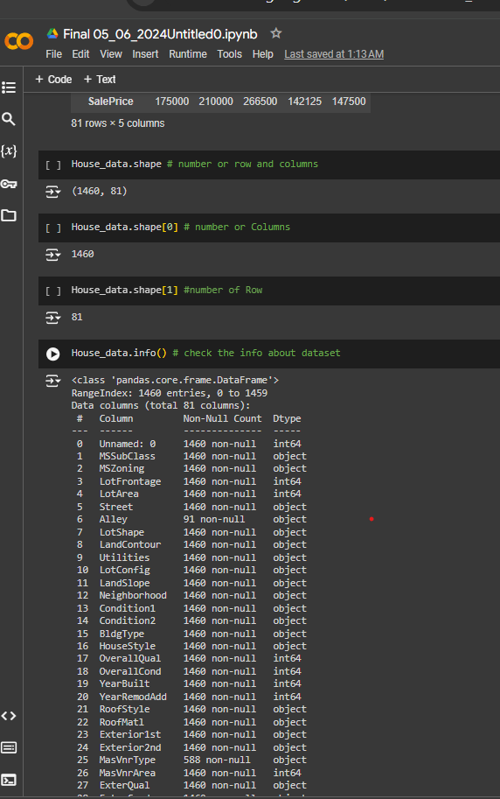
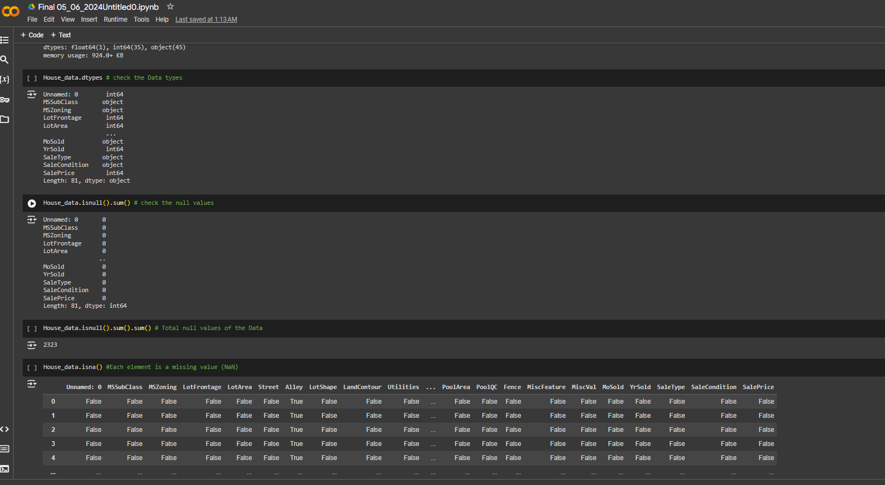

Slide 15
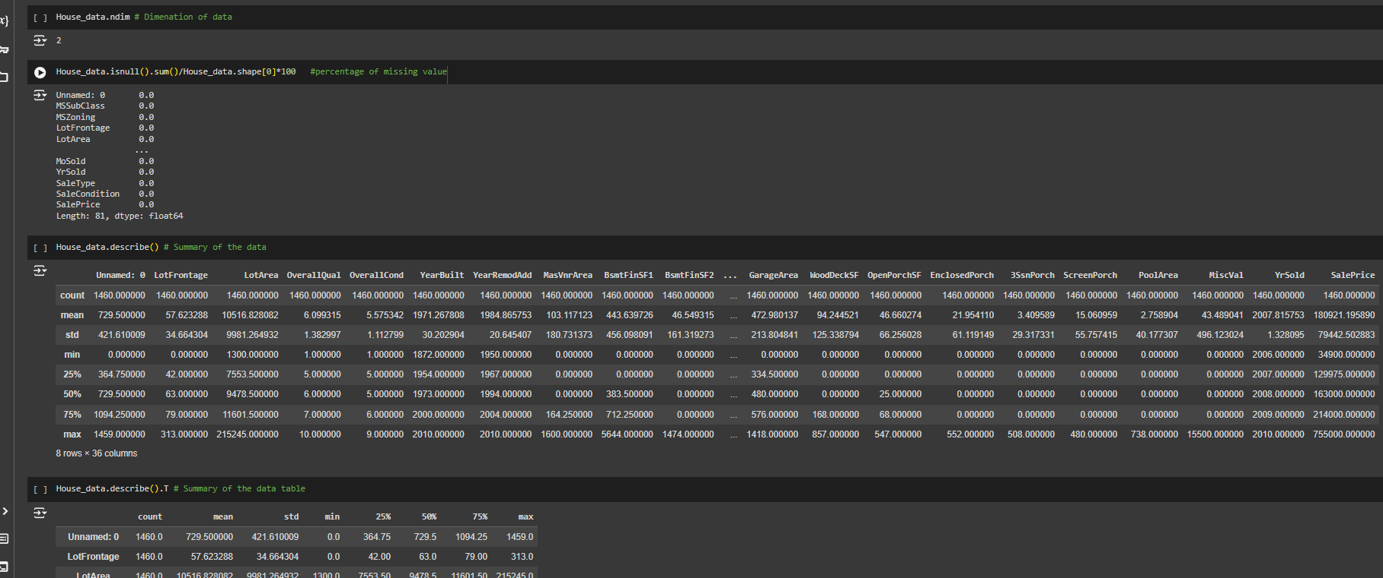
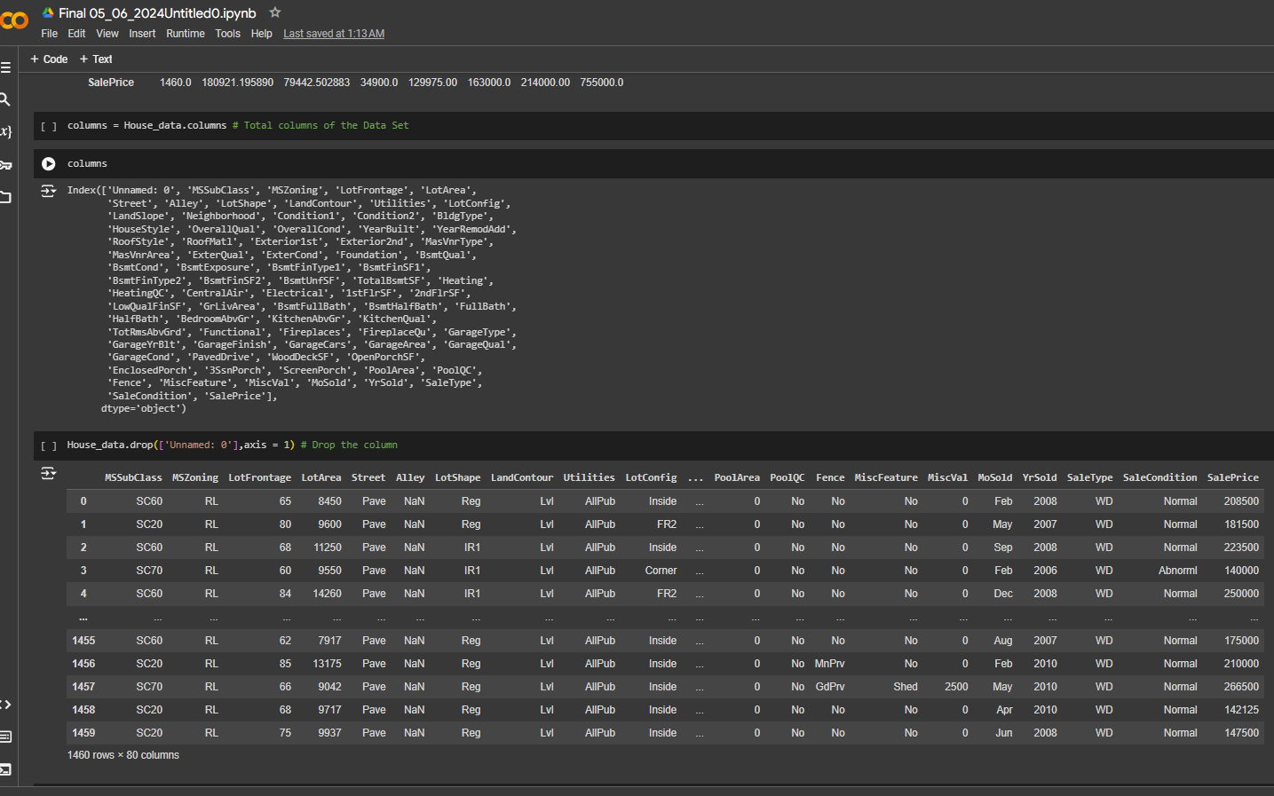
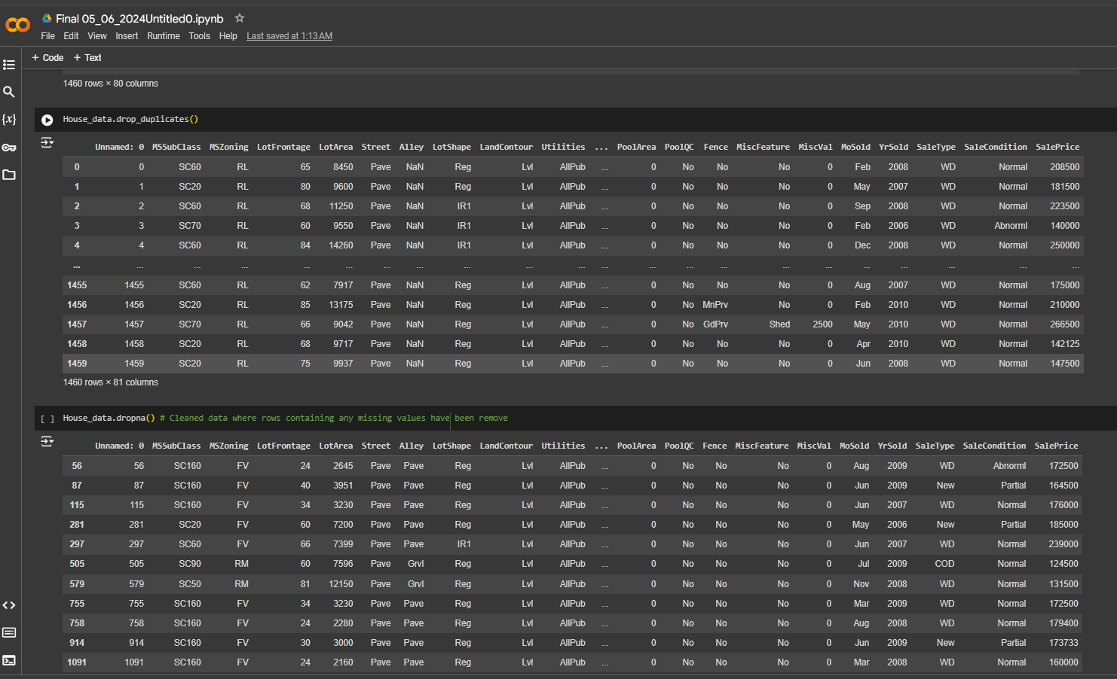
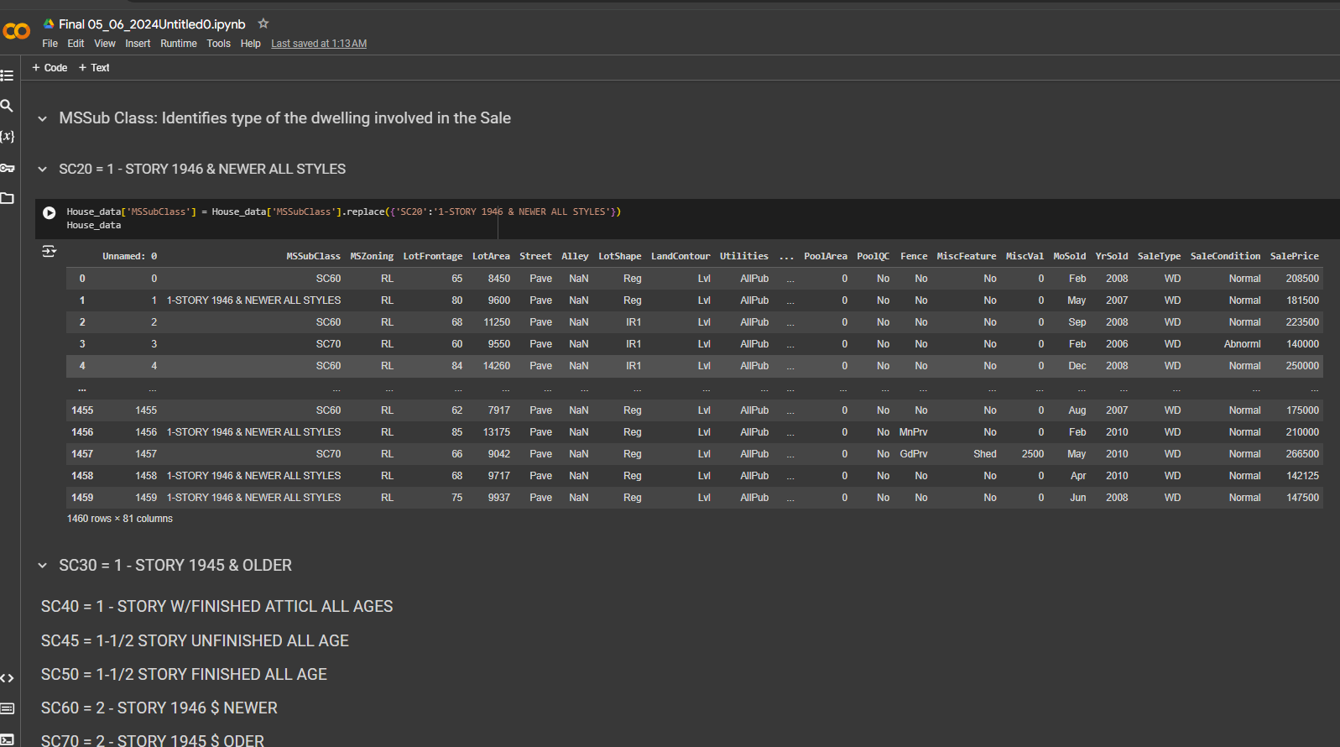

Slide 16
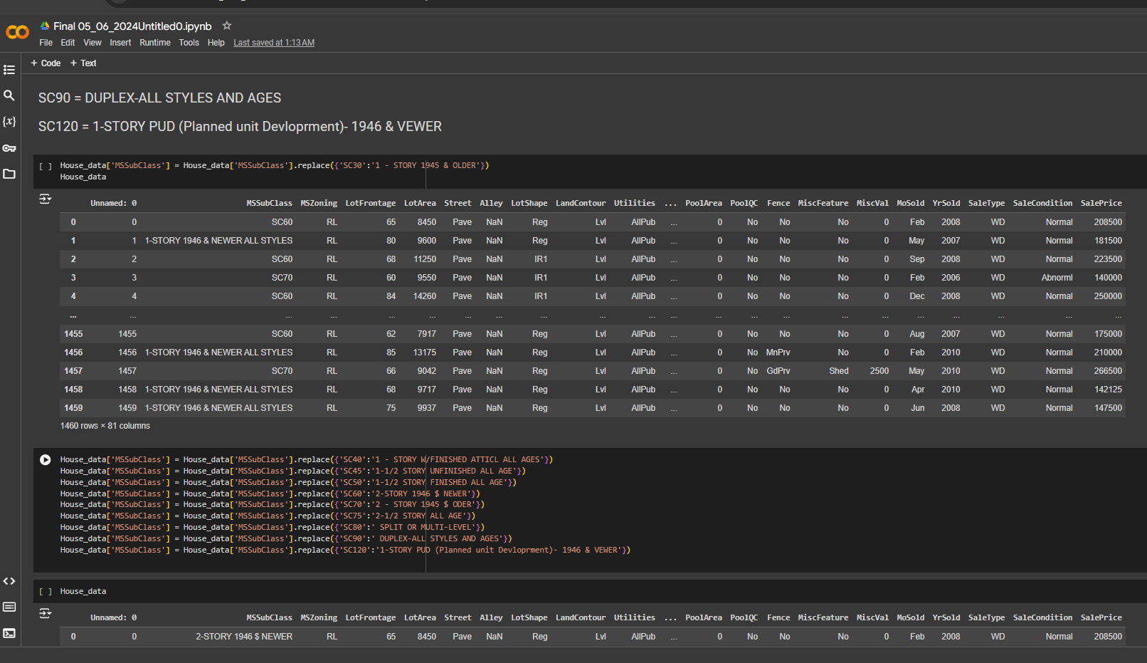
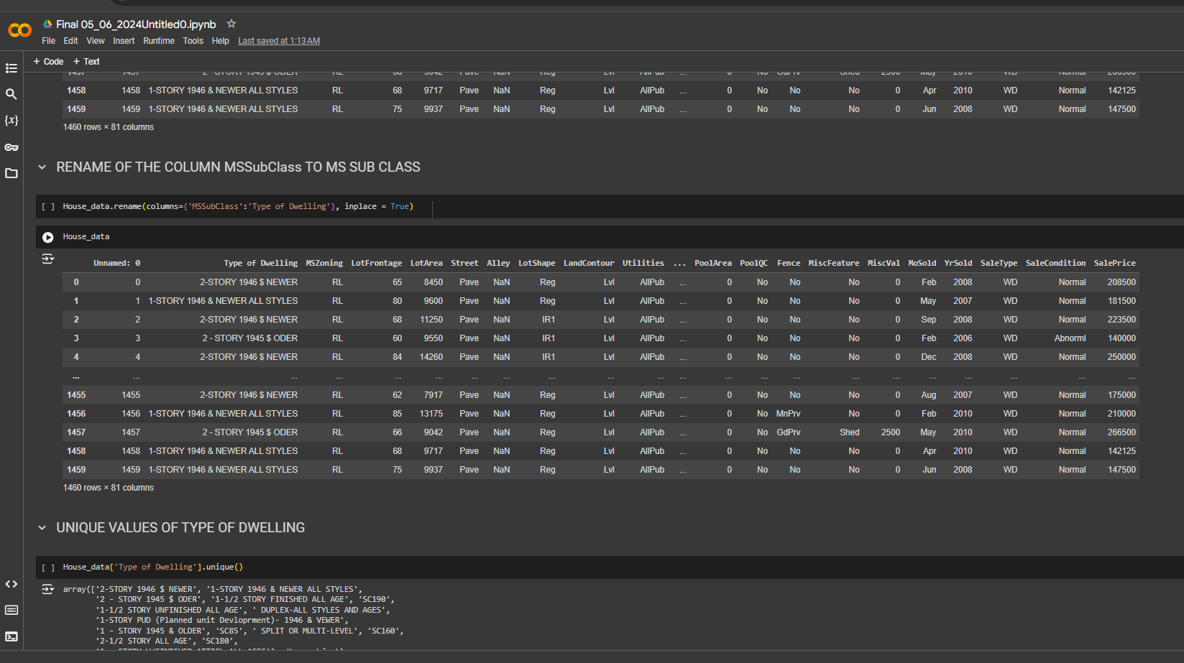
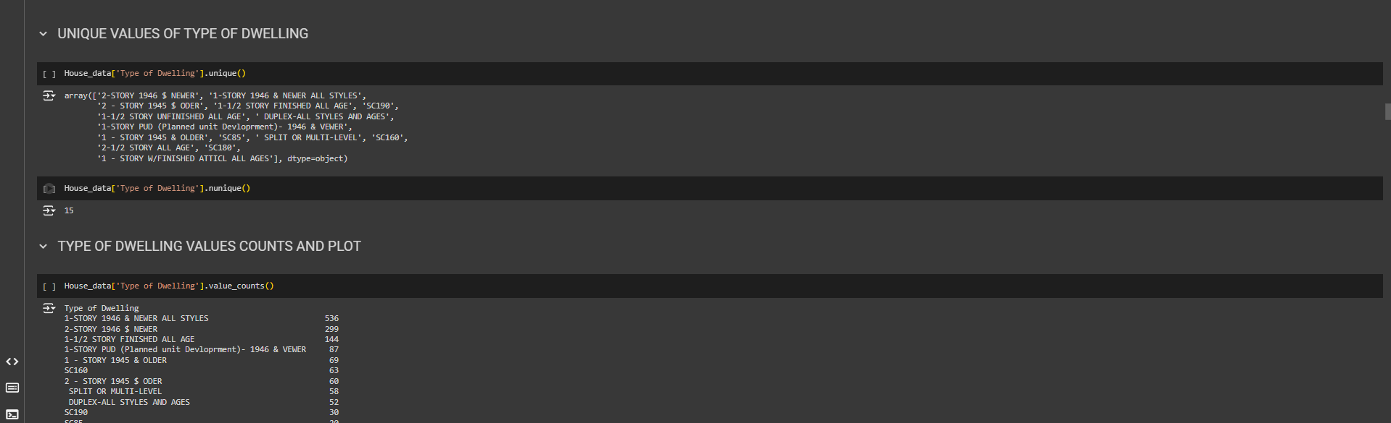
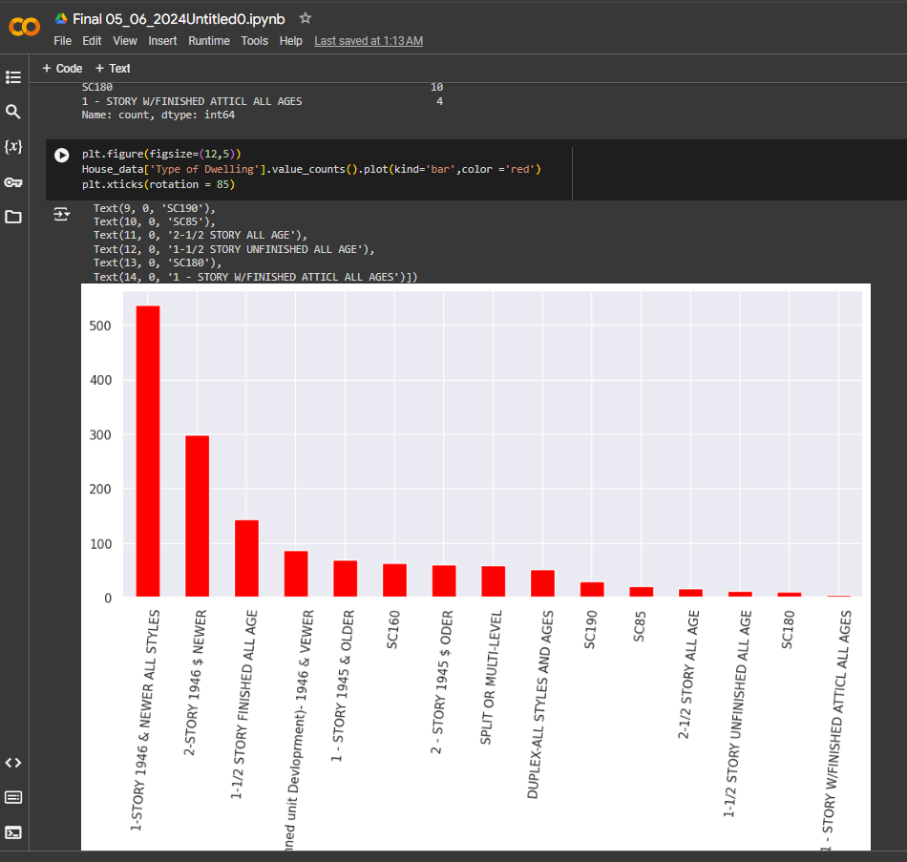

Slide 17
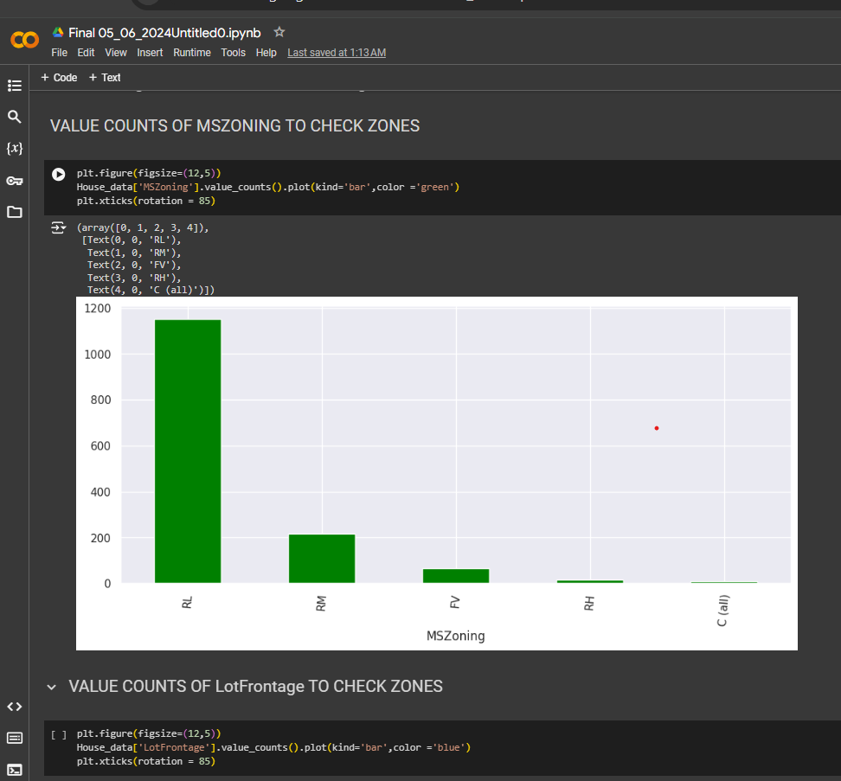
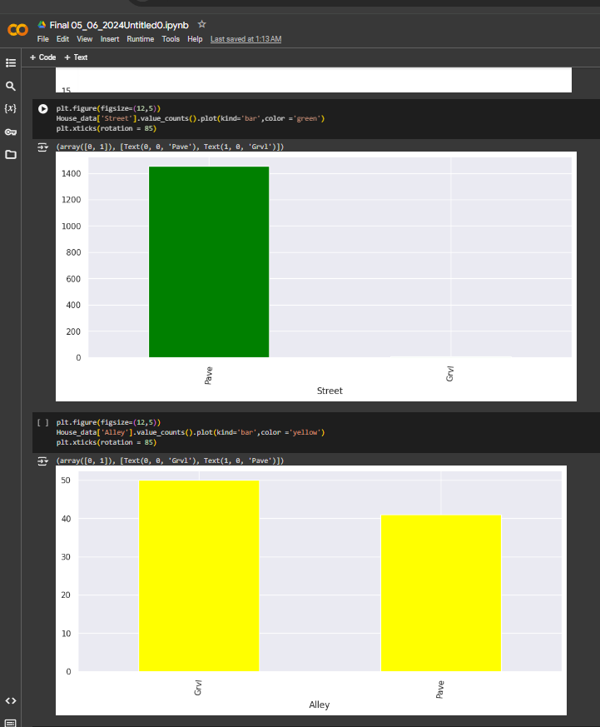

Slide 18
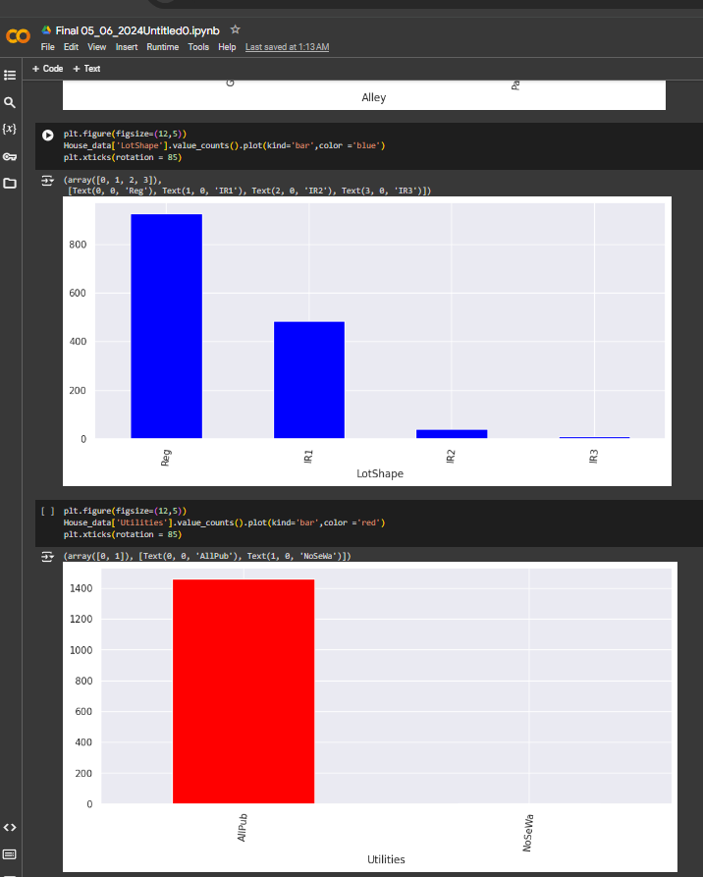
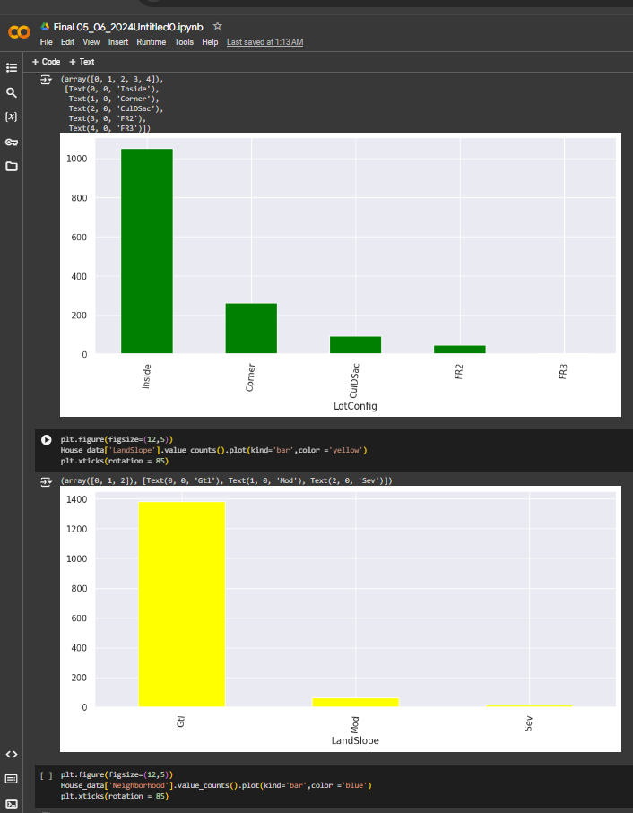

Slide 19
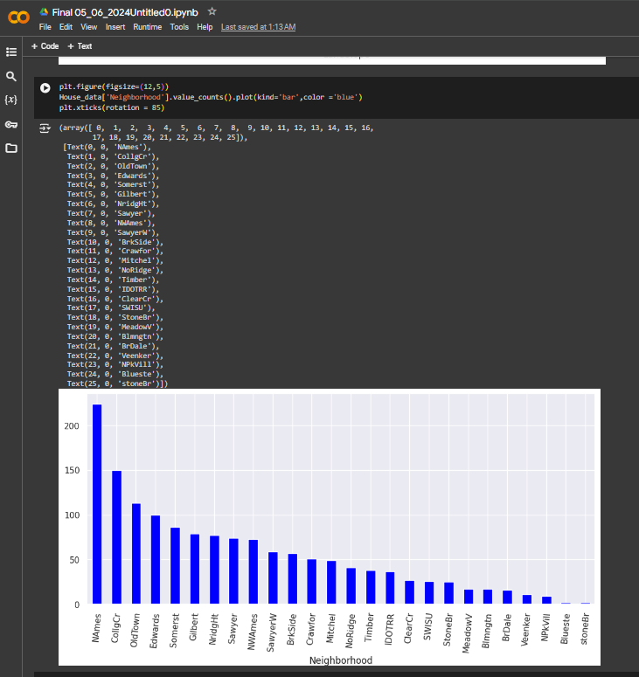
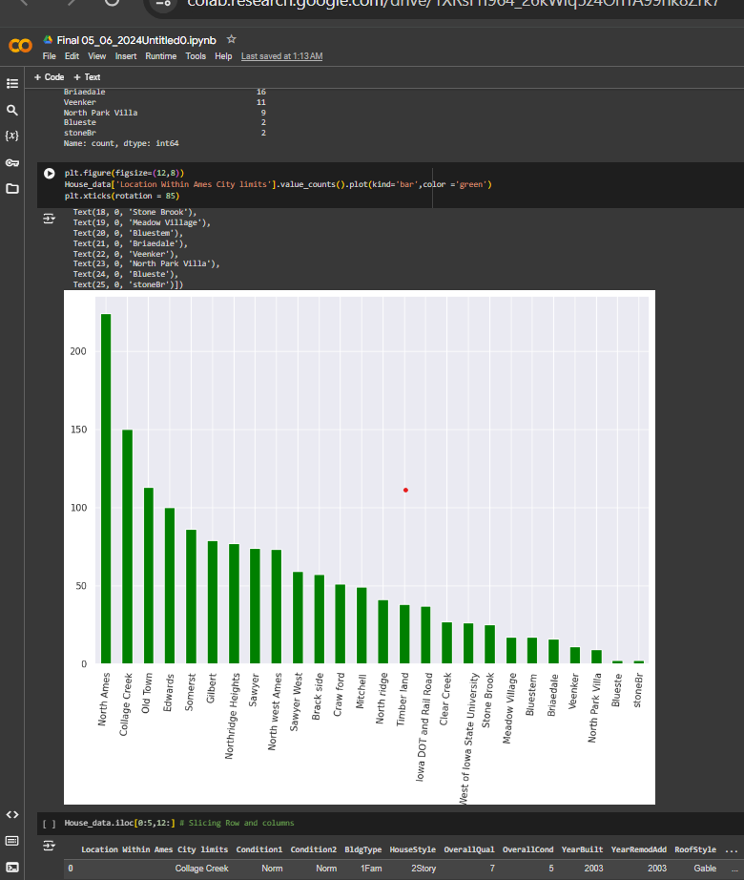

Slide 20
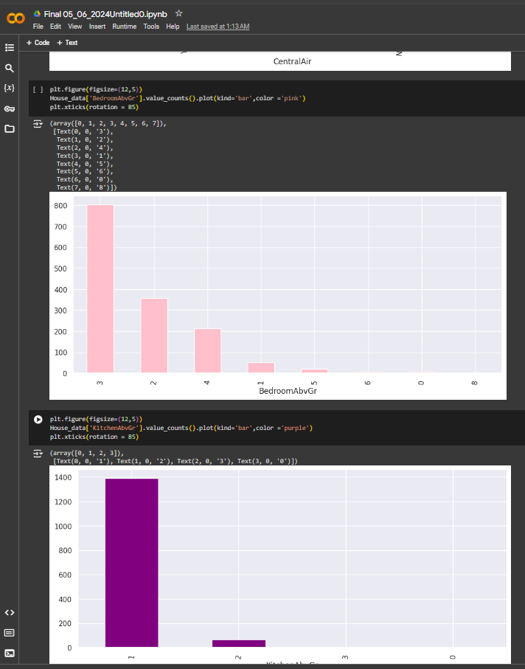
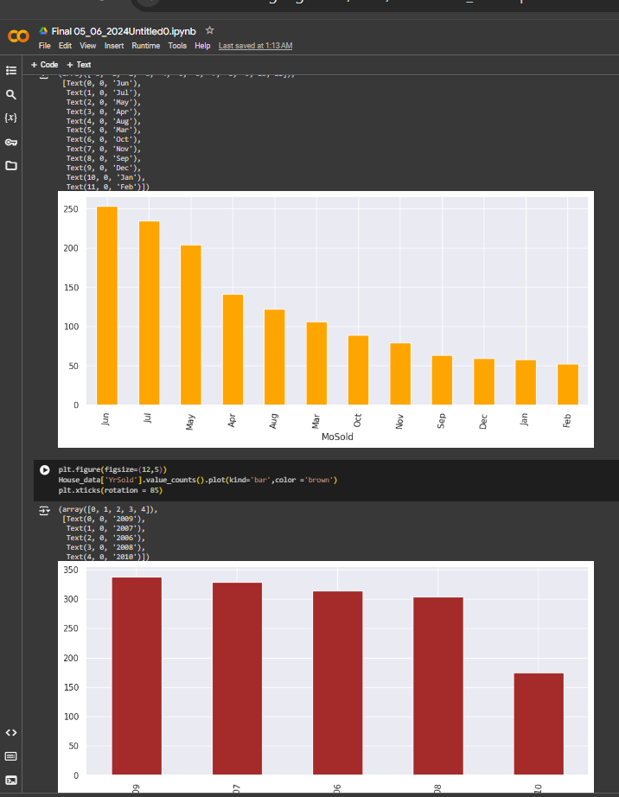

Slide 21
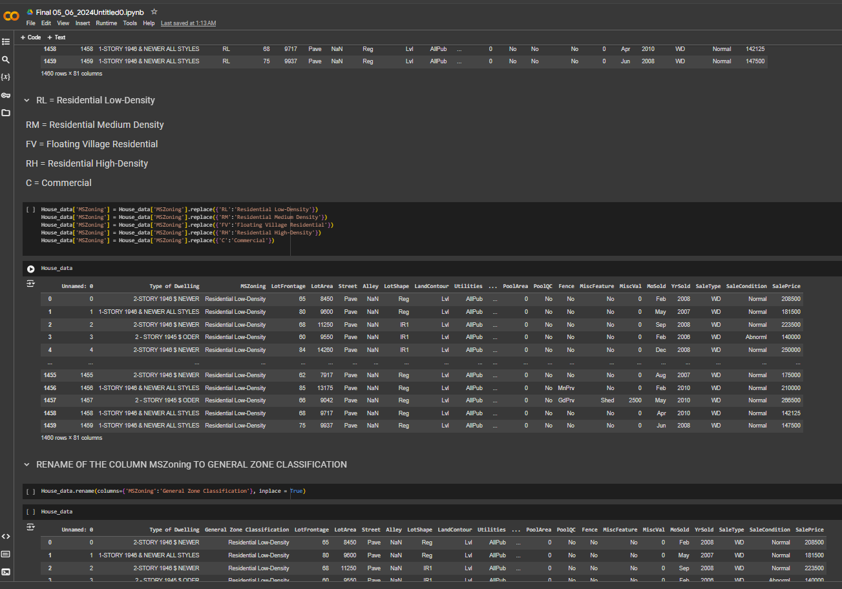
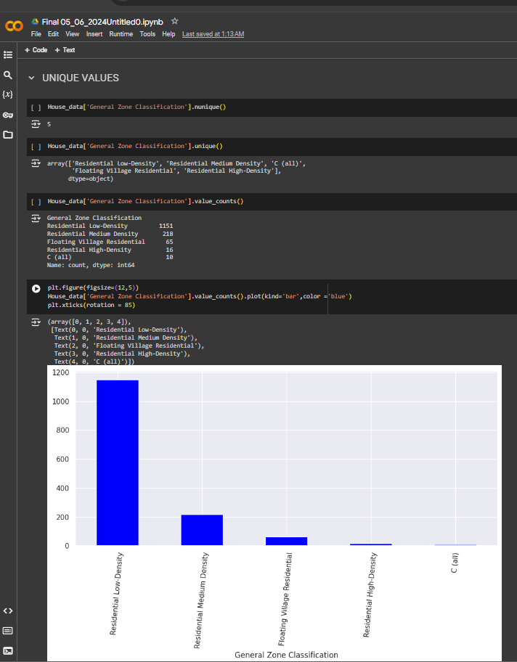

Slide 22
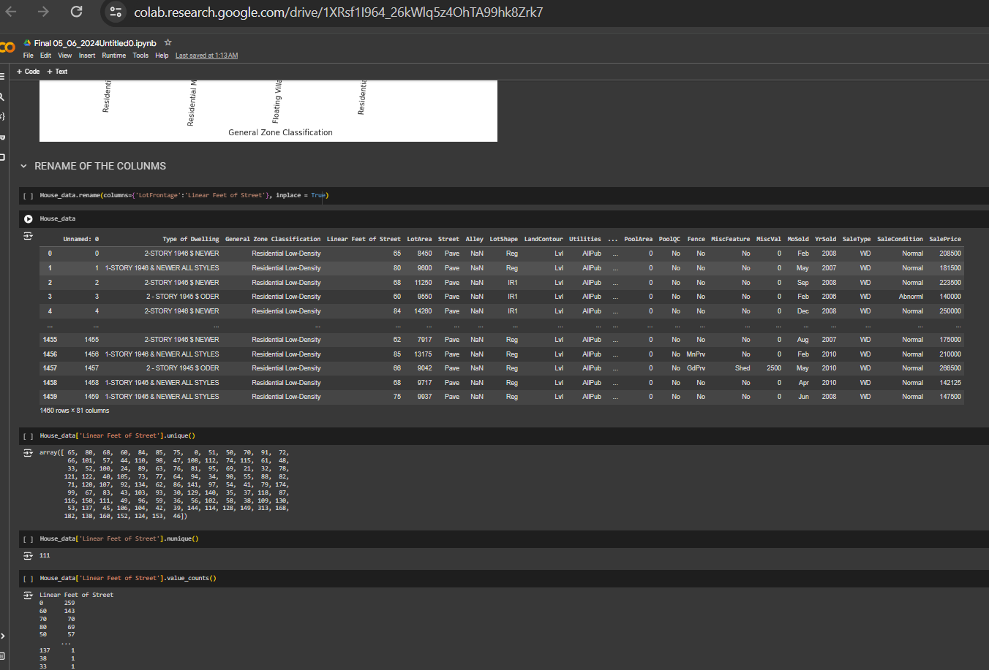
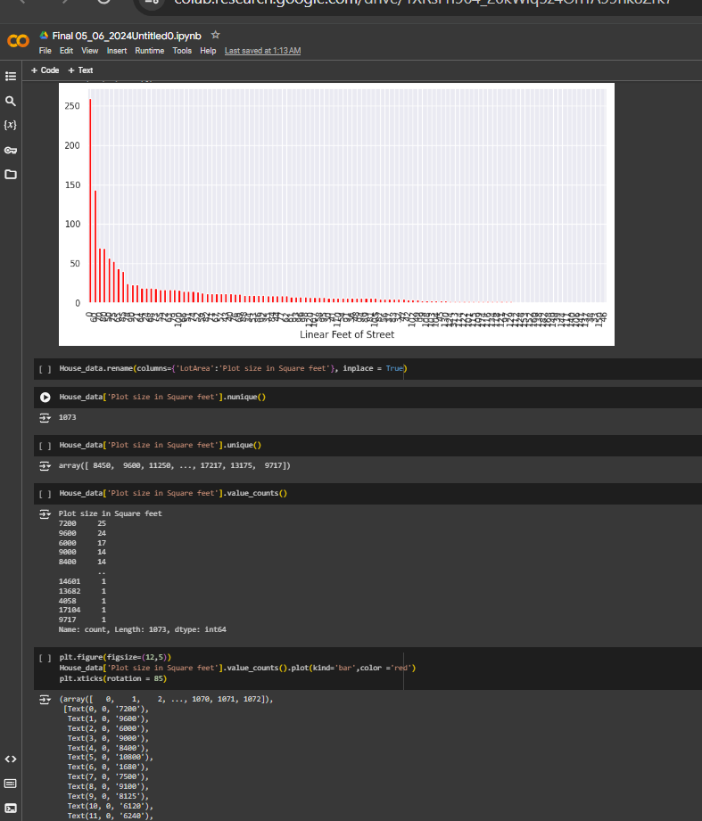

Slide 23
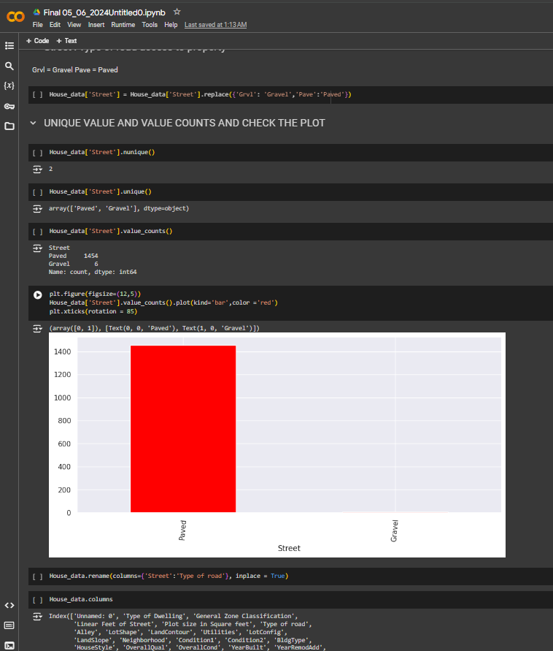
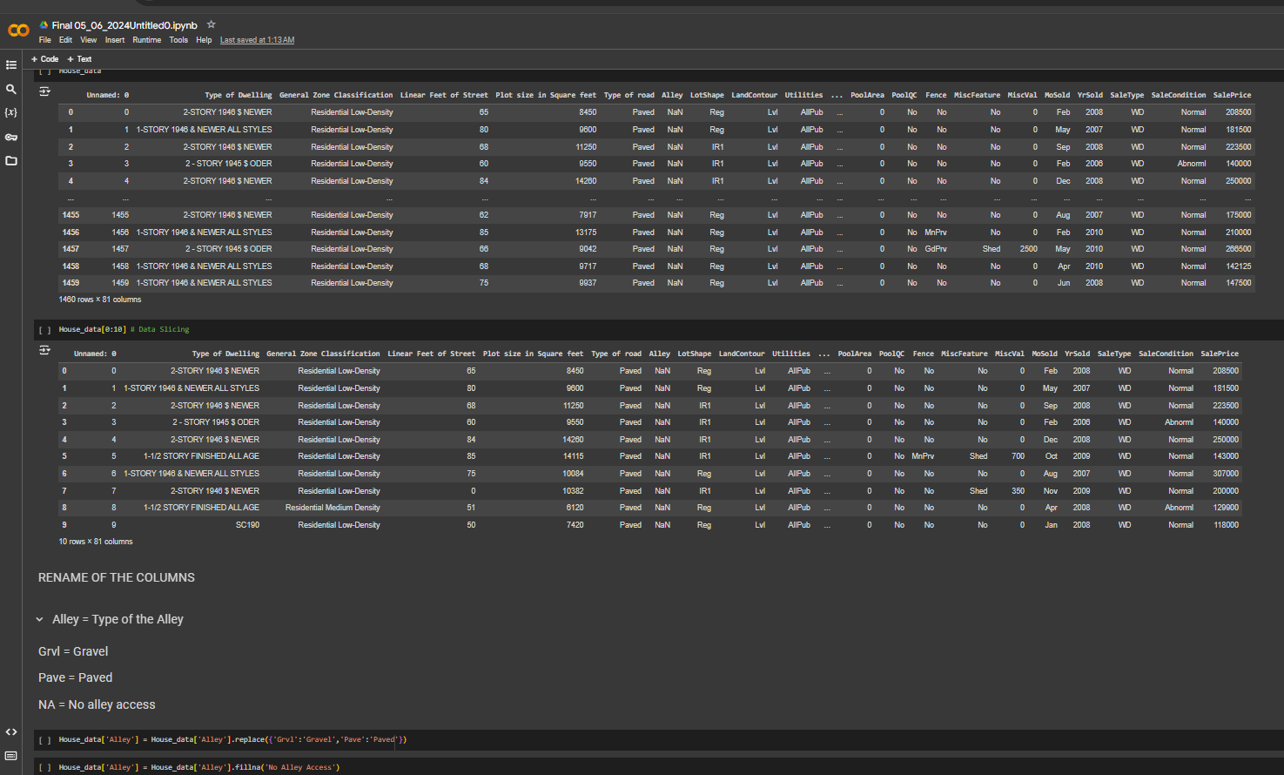

Slide 24
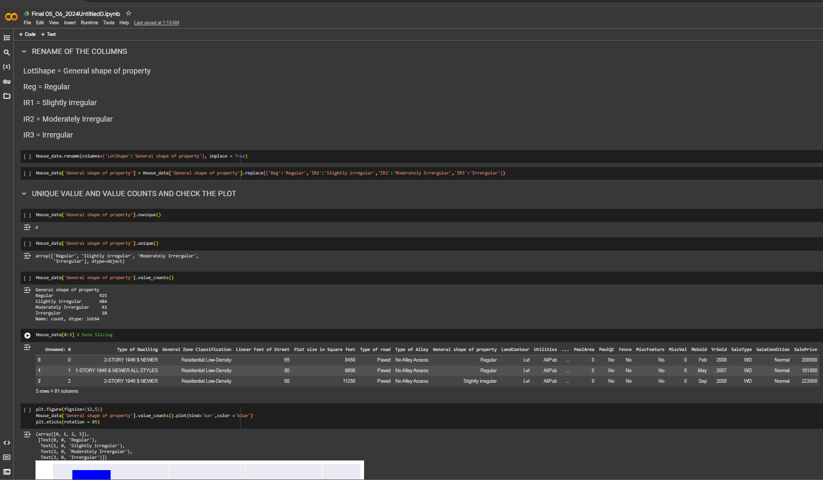
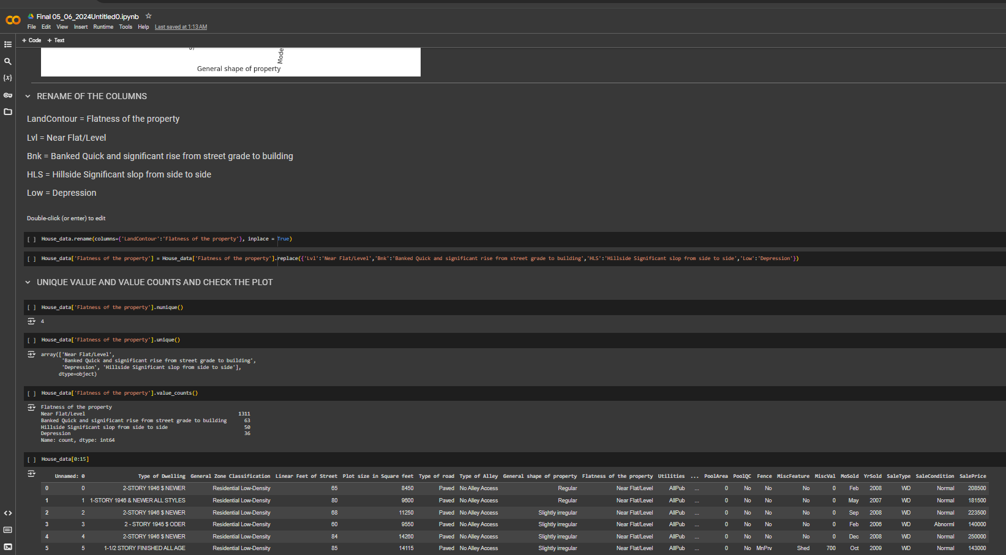

Slide 25
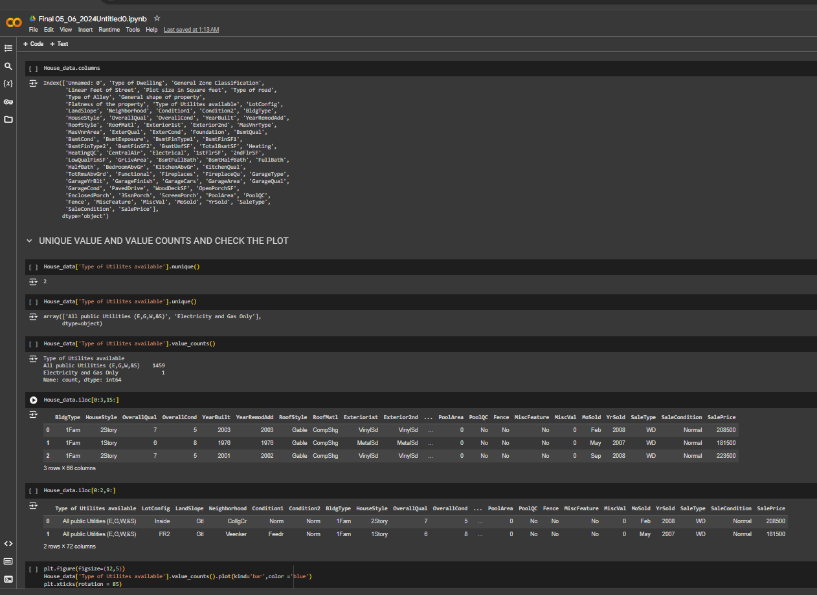
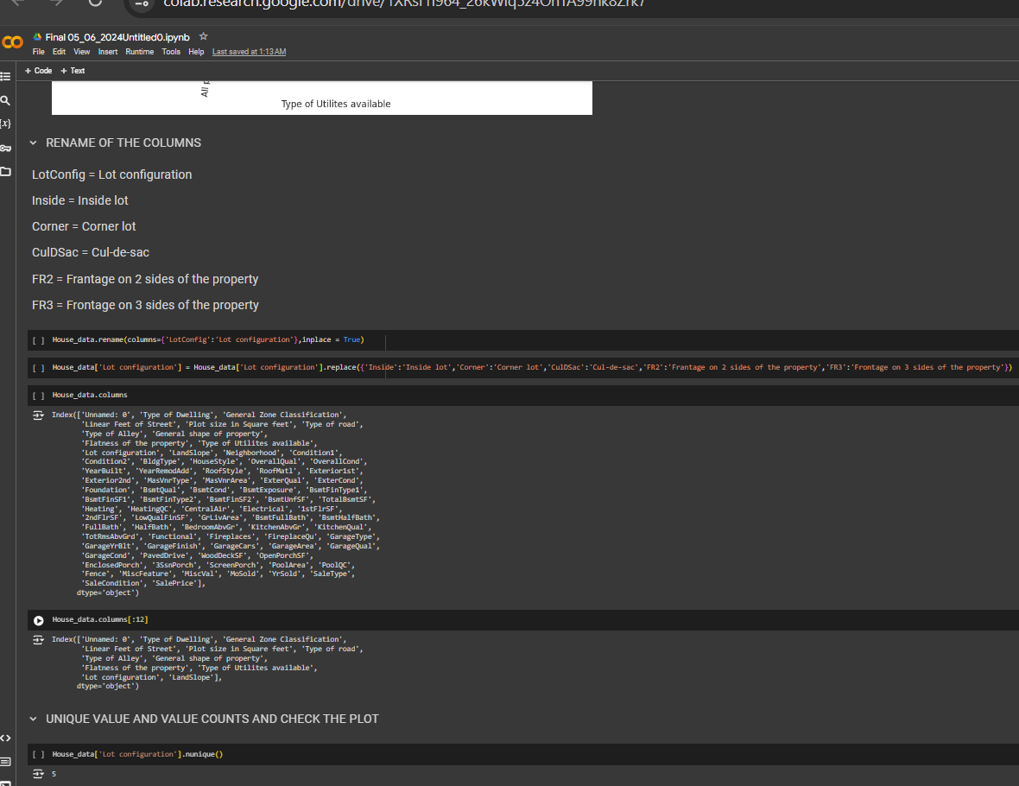

Slide 26
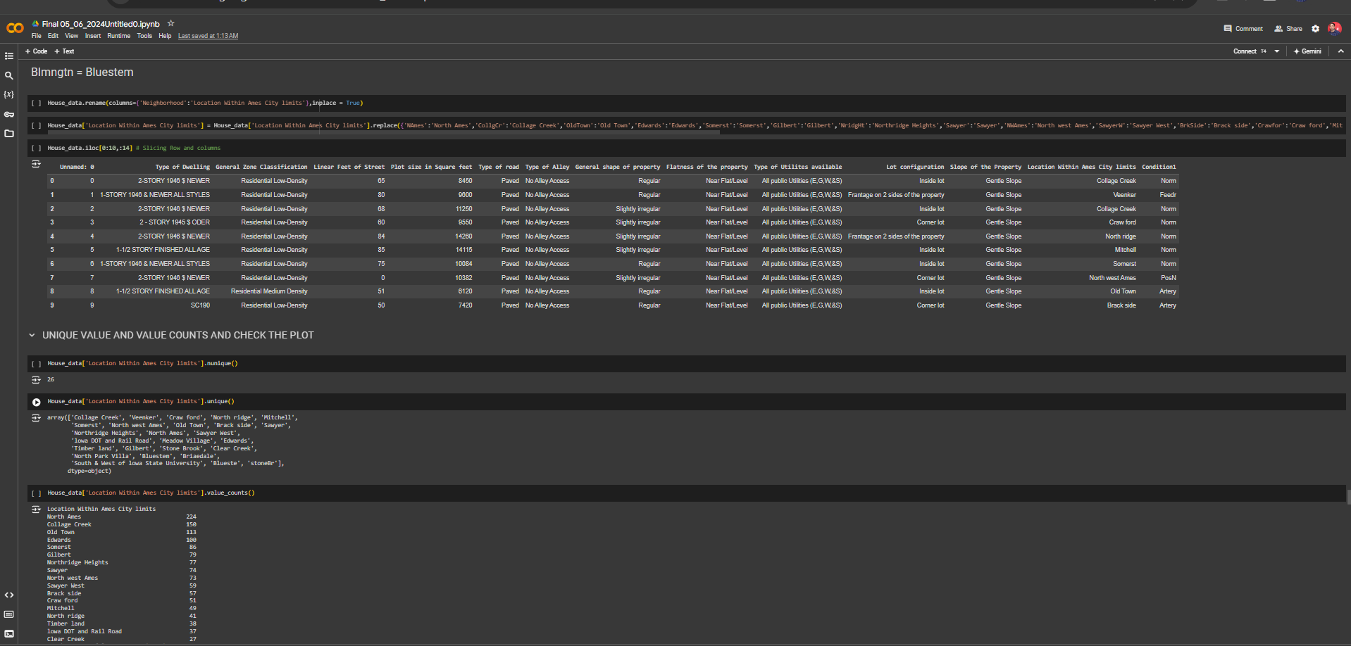

Slide 27
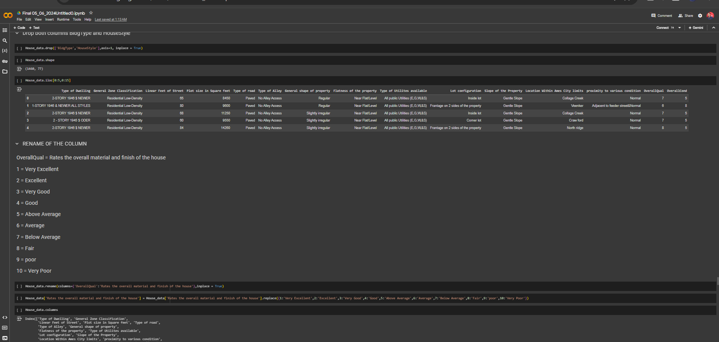
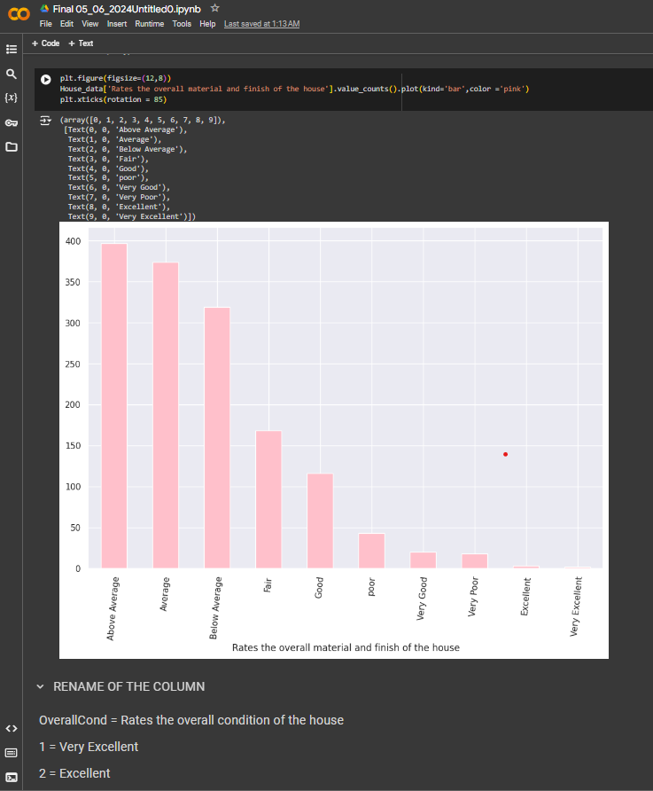

Slide 28
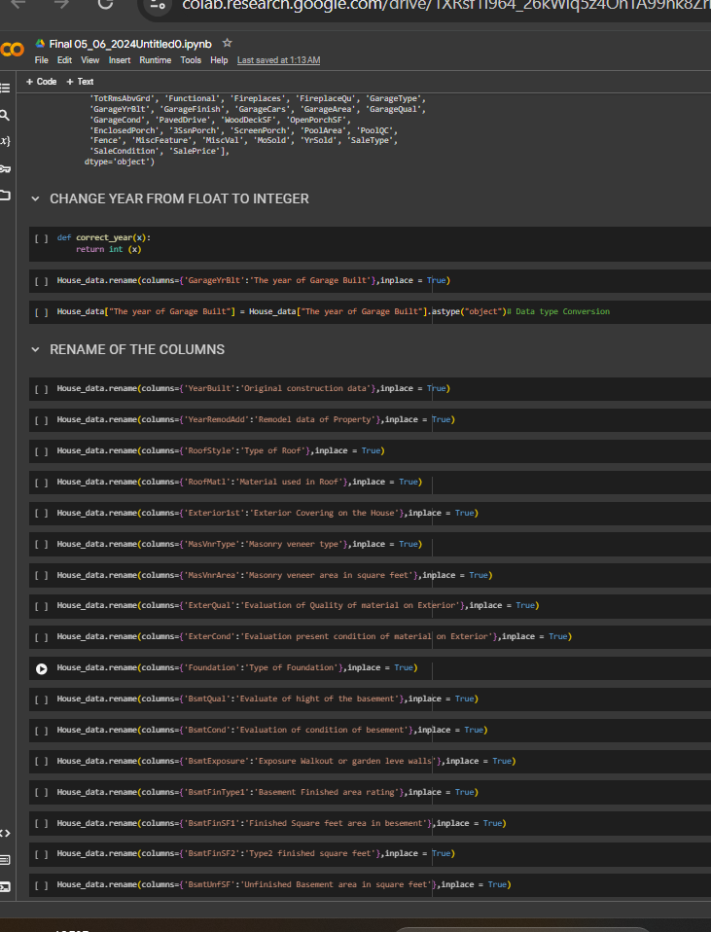
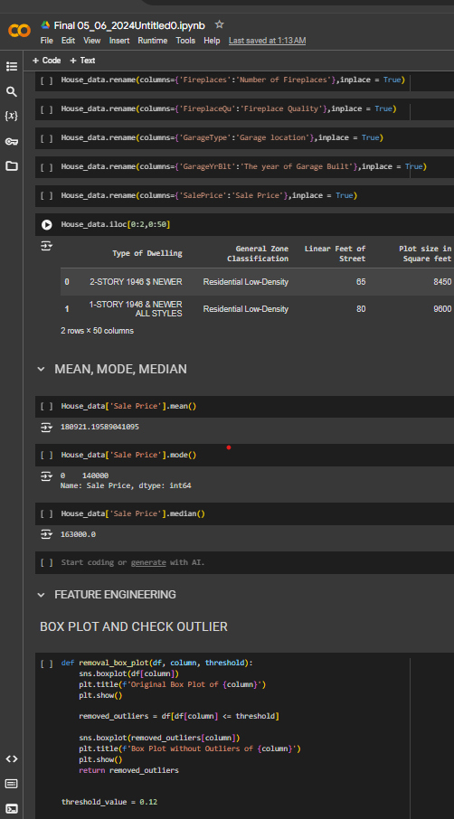

Slide 29
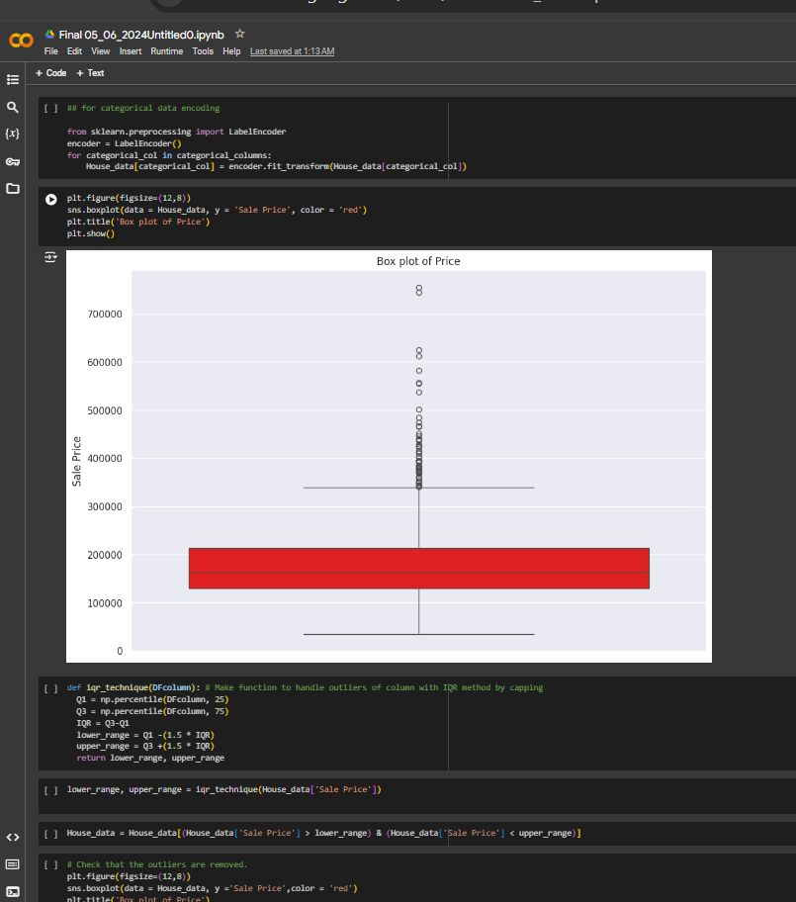
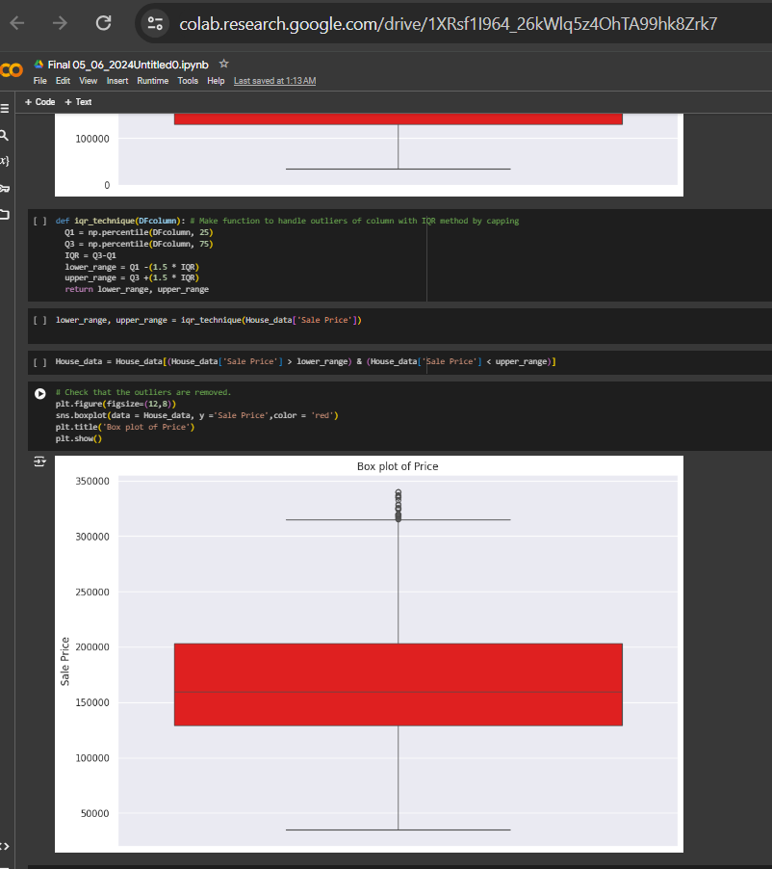

Slide 30
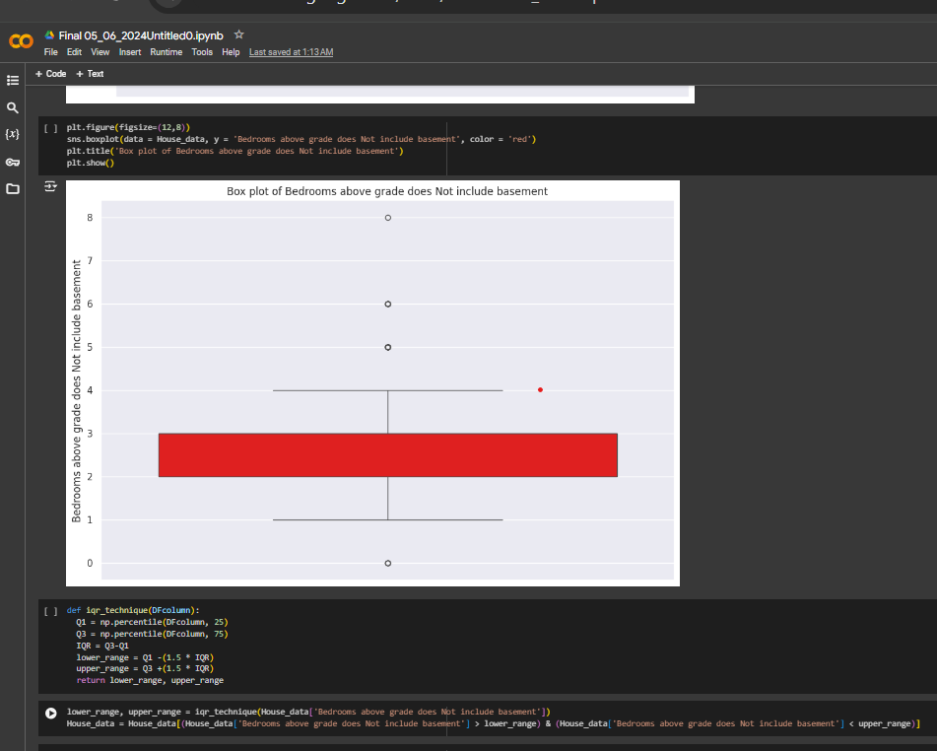
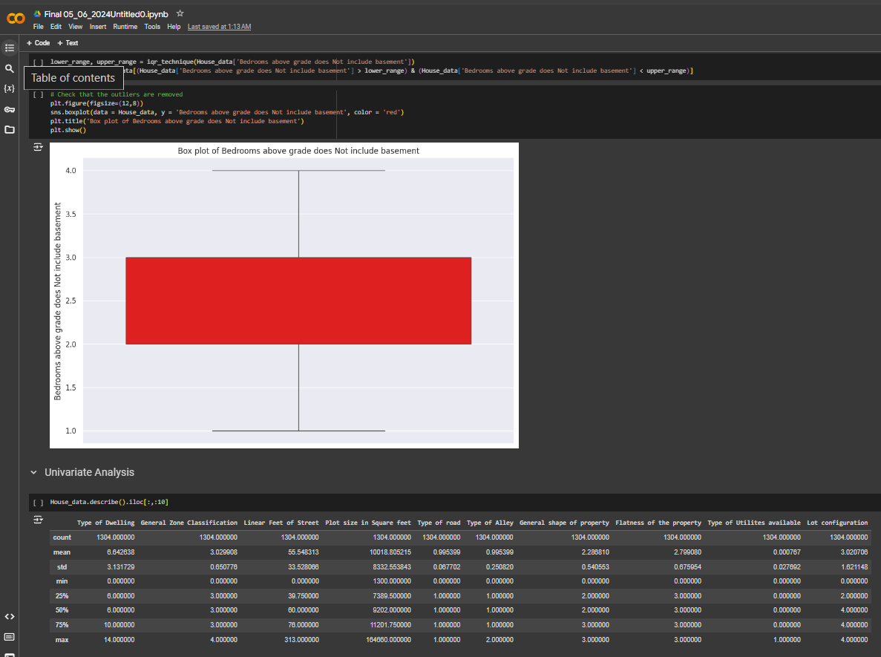

Slide 31
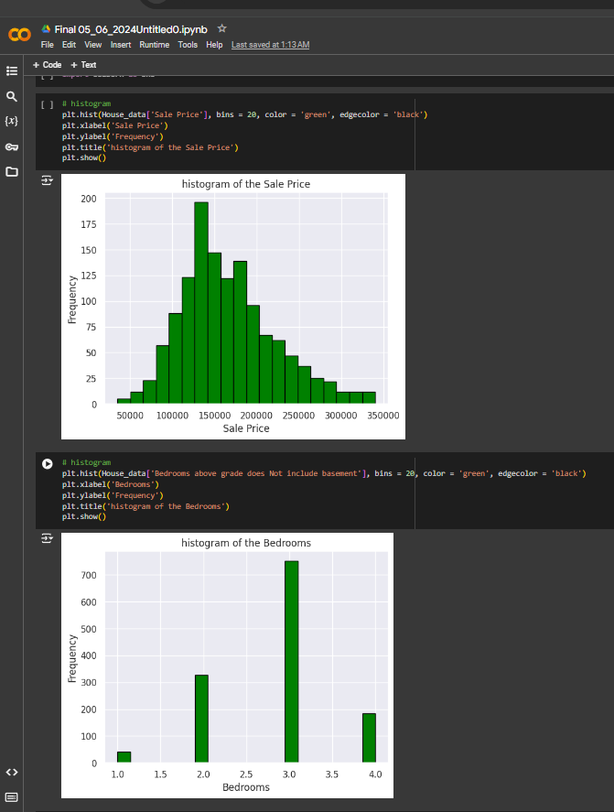
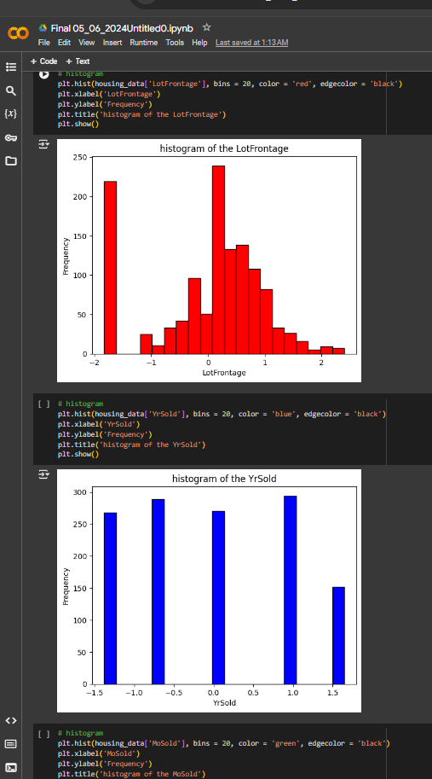

Slide 32
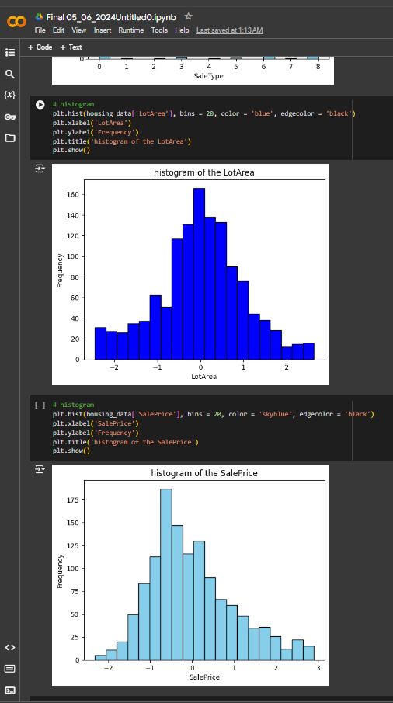
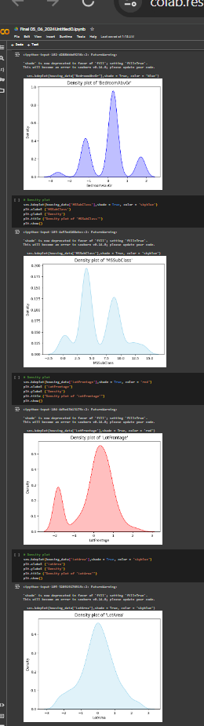

Slide 33
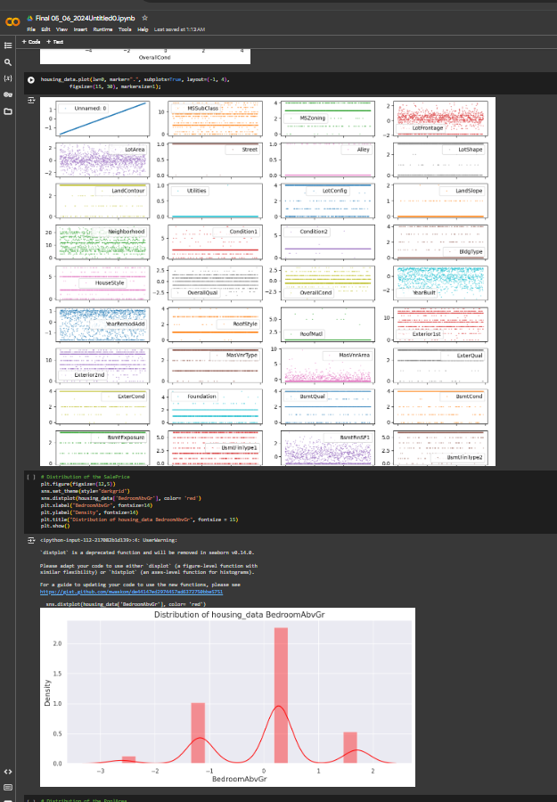
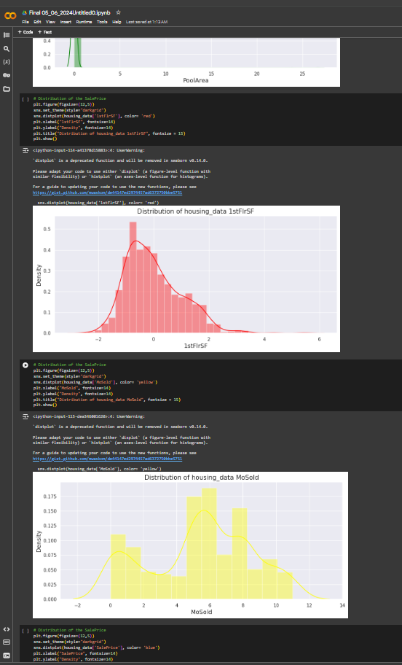

Slide 34
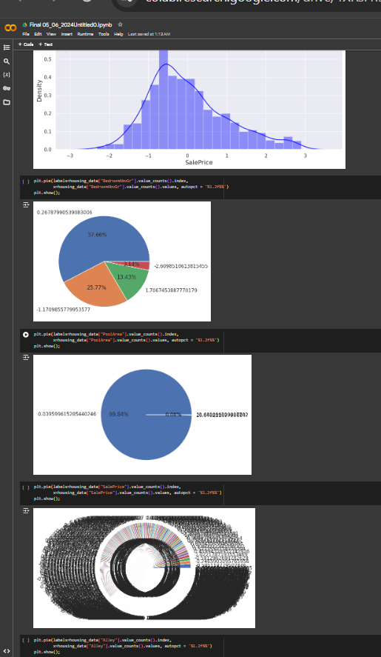
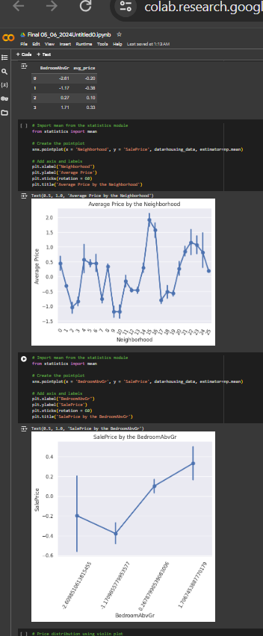

Slide 35
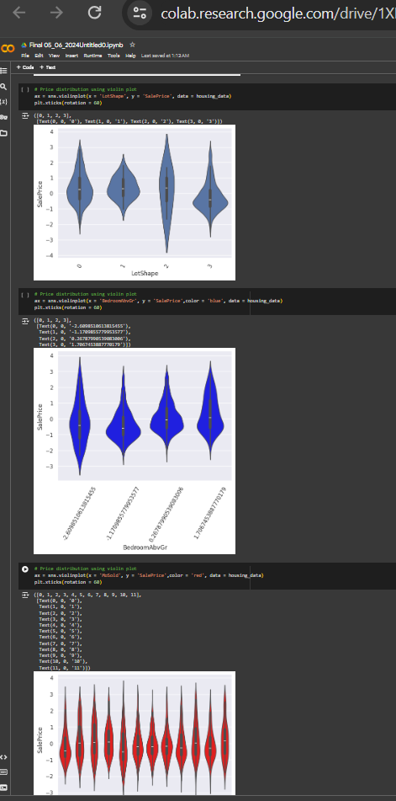
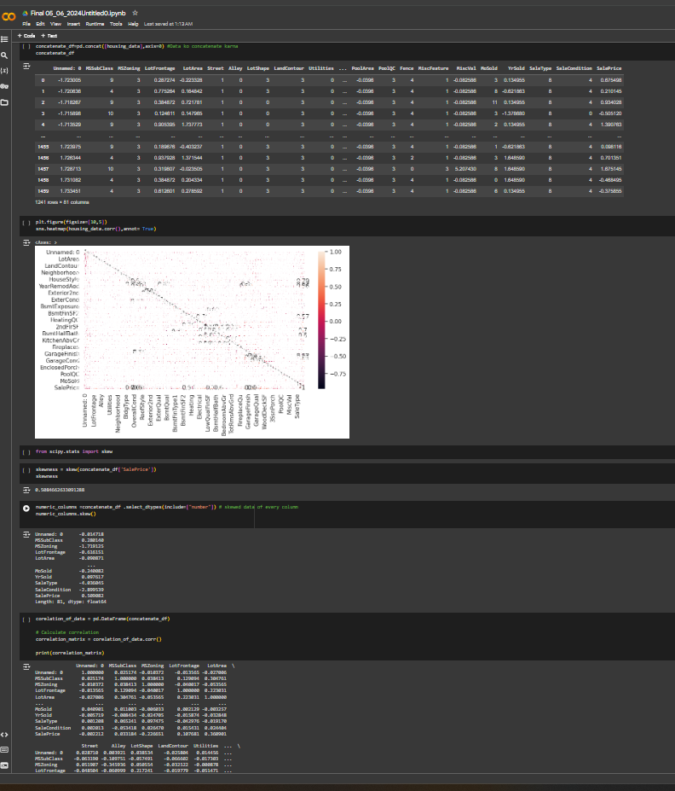

Slide 36
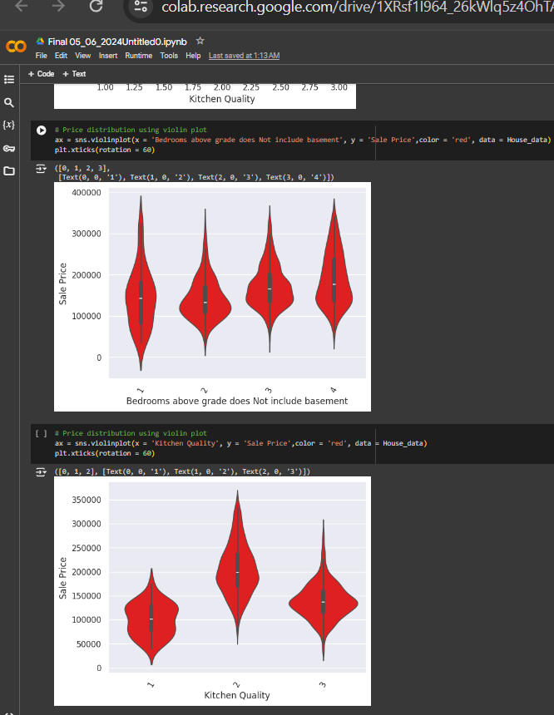



Slide 37


Slide 38


JAI HIND

